Slide 1
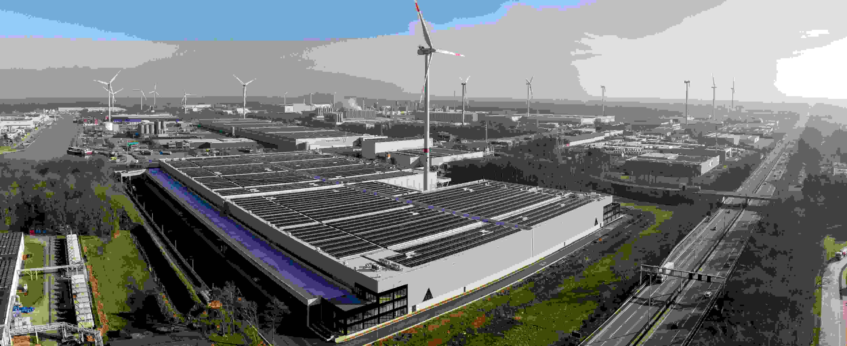
Intervest | Building Logistics Infrastructure Partnering to build the logistics ecosystems behind modern supply chains

Slide 2
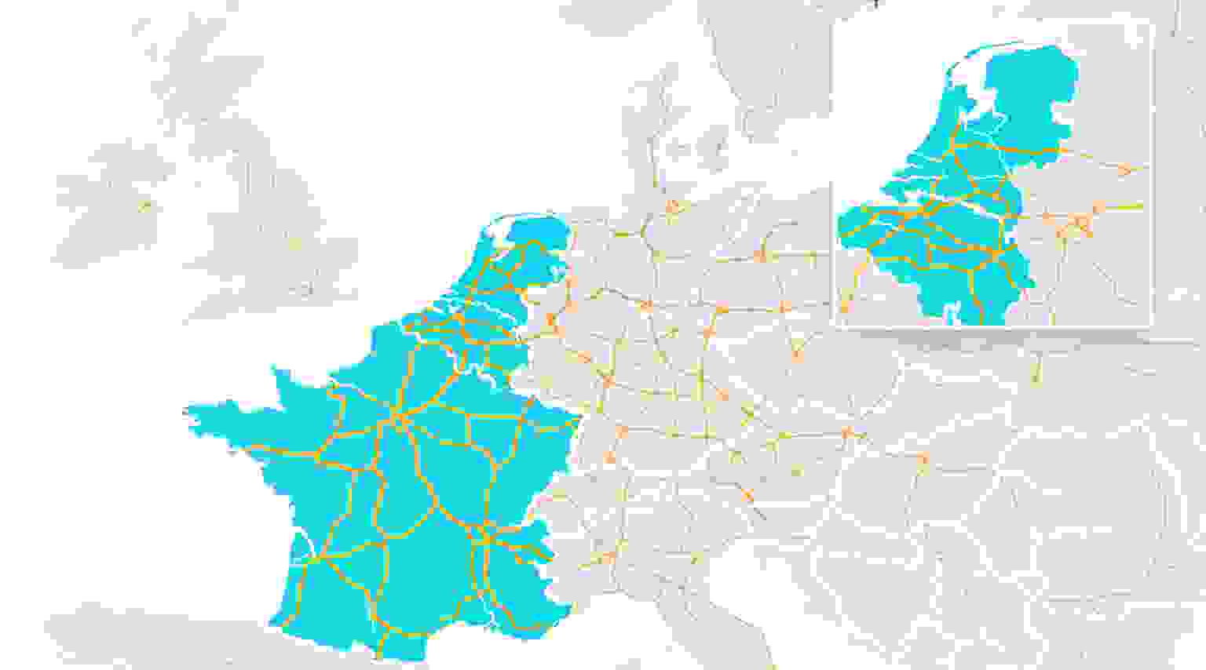
Intervest at a Glance
European platform with core presence in Benelux and France
19
30
€ 2+ Bn
AUM
54
Assets
1.8M m²
Logistic space

Slide 3
Flexible Logistics Estate Solutions
Development
Built-to-suit
Lease
Sale-and-
Lease-Back
Design and develop logistics infrastructure tailored to operational needs.
Access modern logistics space in prime locations.
Unlock capital while retaining operational control
Brownfield redevelopment
Sustainable logistics facilities
Built for modern supply chains
Scalable warehouse capacity
Strategic logistics corridors
Long-term partnership
Release capital for growth
Remain operational on site
Asset management by Intervest

Slide 4
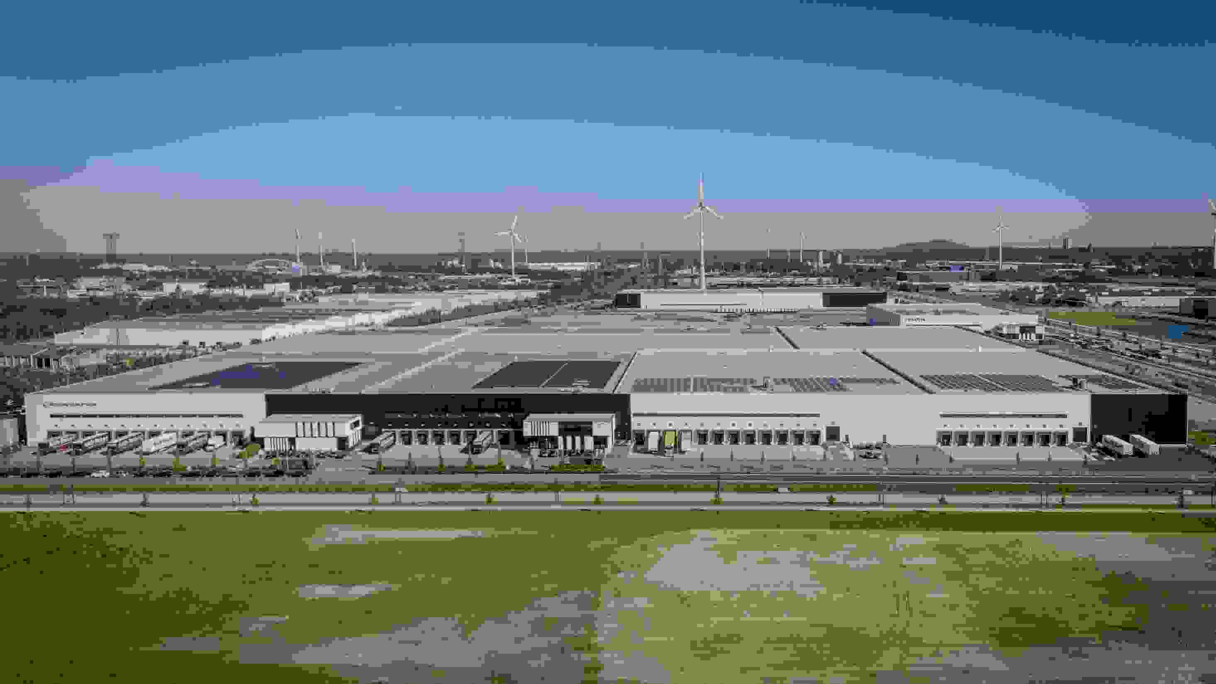
Genk Green Logistics
Future-ready logistics campus
Large photovoltaic installation Supporting low-carbon logistics operations
Large-scale logistics platform in the Genk production region
Energy-efficient infrastructure for modern supply chains
Flexible warehouse units for distribution and fulfilment
High number of loading docks
Optimised for high-throughput distribution

Slide 5
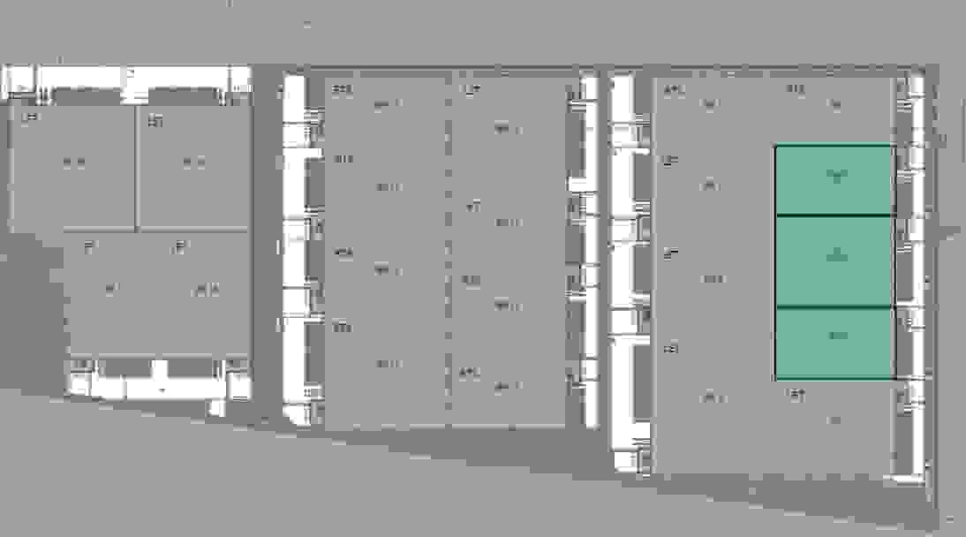
Genk Green Logistics
Development partnership: Intervest + Group Machiels + MG
Logistics development
Logistics development
Total logistics space: ± 96,000 m²
Multiple warehouse units
Flexible unit sizes from ± 8,000 m²
Warehouse specifications
Clear height: 12.2 m
Floor load capacity: 5 T/m²
ESFR sprinkler system
High number of loading docks
Sustainability
Large rooftop photovoltaic installation
Energy-efficient warehouse design
Future-ready logistics infrastructure
BTS
BTS
BTS
let
BTS
let
let
BTS
let
Warehouse specifications
let
BTS
let
BTS
let
let
BTS
BTS
let
BTS
let
Sustainability
Key distances from Genk:
Antwerp 90 km | Liège Airport 51 km | Maastricht Airport 27 km | Duisburg 120 km | Brussels 90 km

Slide 6
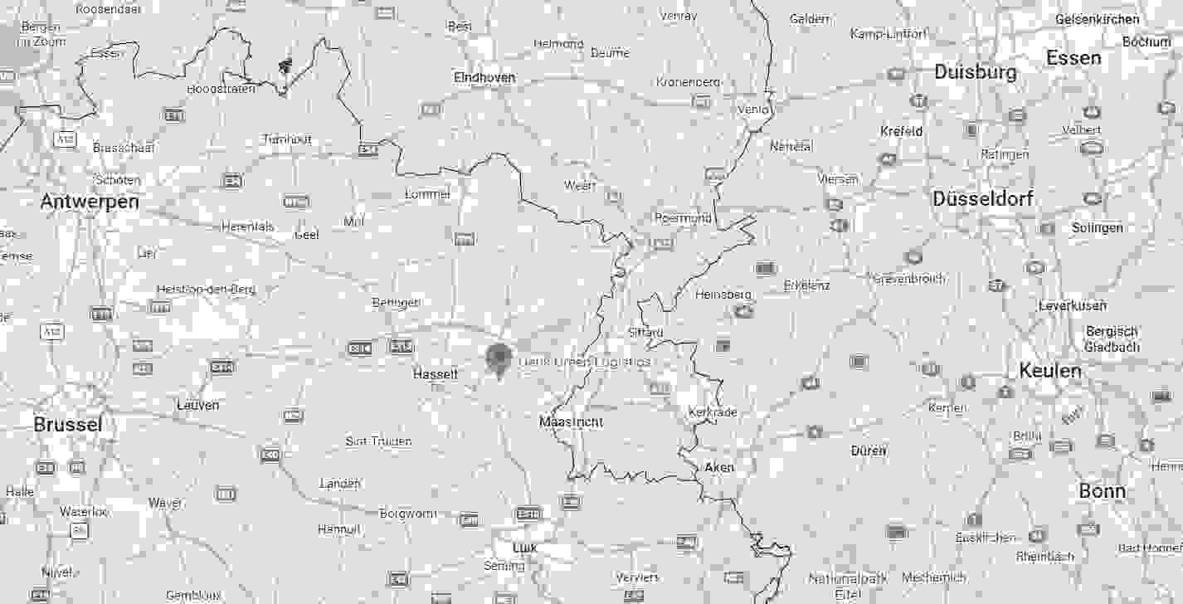
Genk Green Logistics
Multimodal access to key logistics corridors
Site connectivity
Multimodal access
On-site barge & rail terminal – Port of Limburg
Dedicated trailer parking & service zone
Logistics ecosystem
On-site logistics training center
Shared park management
(security, sprinklers, services)
Accessibility for workforce
Improved public transport access
Potential horeca facilities on site
Site connectivity
Logistics ecosystem
Accessibility for workforce
Antwerp 100 km | Liège Airport 50 km | Brussels 95 km | Cologne 140km | Duisburg 130 km

Slide 7
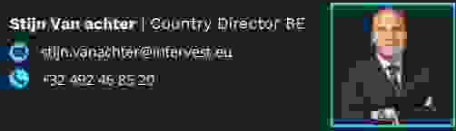
How can we help?

